Slide 1
City of Port Orford Effluent Wastewater Keep Disposing Into the Pacific Ocean or Provide for Beneficial Reuse?

Slide 2
DEQ Water Reuse Program
The protection of Oregon's water is one of DEQ's highest priorities and water reuse helps support the efforts towards water sustainability. DEQ's work in water reuse dates back to 1990, and this practice is utilized both nationally and internationally to protect water resources.
Through proper management, the reuse of water can provide social benefits. It can add to economic vitality, deliver critical water access, aid in ecological restoration, supplement infrastructure resilience, improve water quality, and establish a more reliable water supply. Water reuse can be especially beneficial when it comes to increasing drought resilience and instream and groundwater supply protection.

Slide 3
Where to dispose effluent wastewater is a policy decision for the City of Port Orford;
Keep dumping effluent wastewater into the ocean, the only present choice.
Make it available for beneficial reuse.
Providing a secondary outfall does not obligate the City of Port Orford to anything.
Any user of recycled wastewater is responsible for paying for the new point of diversion, and system.
Any user must obtain permits (RWUP & WPCF) from the DEQ.
Engineered development proposals reviewed & approved by both the Planning Commission, and City Council.

Slide 4
Effluent Wastewater Reuse Benefits for Port Orford:
The city would no longer be solely reliant on its existing wastewater discharge pipe, which has been vulnerable to ocean storms, and future disposal will eventually become more restrictive.
ERPD will indemnify the City of Port Orford from all additional costs/liabilities associated with the proposed modifications to the effluent wastewater outfall, and costs associated with operating modifications.
Other users, including the City of Port Orford, would be able to reuse the wastewater for irrigation, provided they have an approved RWUP and WPCF, with the DEQ.
Would provide the city a new easement for a gravity flow sewage collection for areas served by the city sewer system, diminishing the cost of replacing existing lift stations, eliminating occasional city non-compliance issues. This could save the city an estimated $250K (The Dyer Partnership).

Slide 5
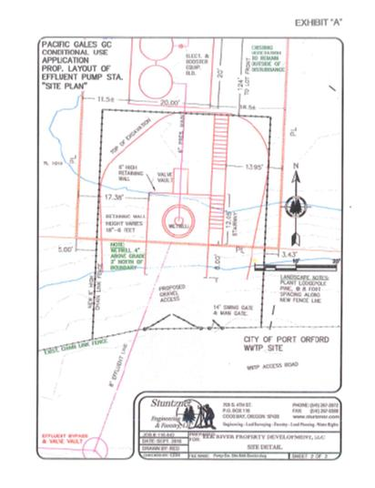
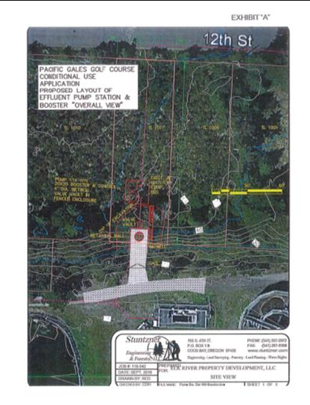

Slide 6
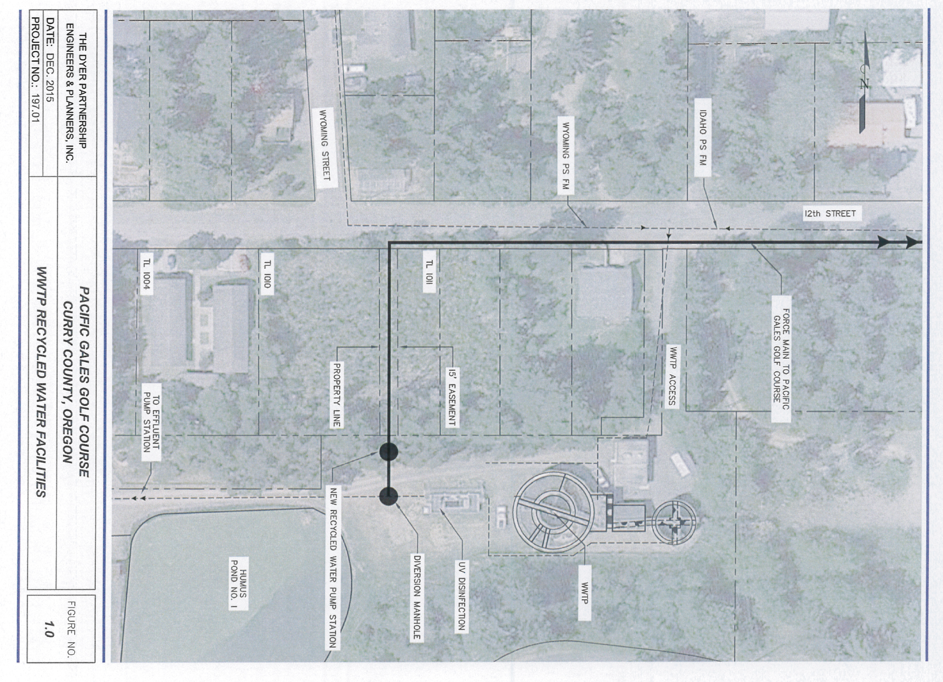

Slide 7
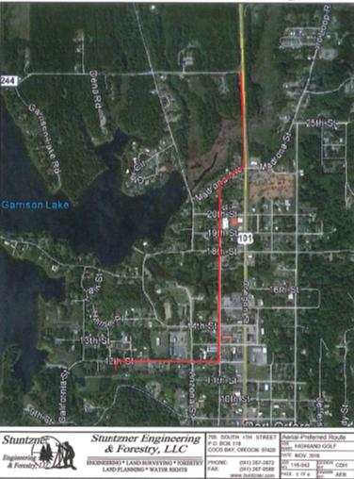
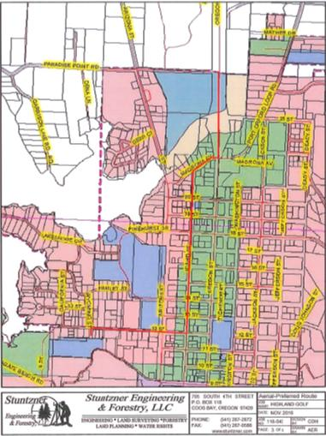
Pipeline route through Port Orford

Slide 8
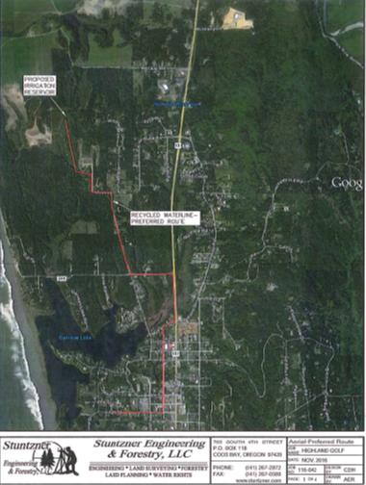
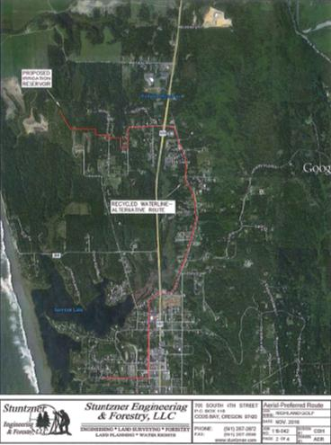
Two approved routes: Preferred & Optional

Slide 9
 | Proposed Wastewater Forcemain from Port Orford WWTP to Knapp Ranch
 | Breakdown of tasks |  |  |  |  |  |  | Estimated timeline (in weeks)
 |  |  |  |  | Start | Duration
 |  |  |  |  | Week | (weeks) |  | Estimated Project Duration (X = 1 week)
Project Startup & Meetings |  |  |  |  | 1 | 2 |  | XX
Prepare Base Mapping |  |  |  |  | 2 | 2 |  | XX
Predesign Report |  |  |  |  | 3 | 2 |  | XX
Prepare 90% Construction Plans |  |  |  |  | 4 | 3 |  | XXX
DEQ First Review |  |  |  |  | 6 | 8 |  | XXXXXXXX
Final Plans & Specifications |  |  |  |  | 13 | 4 |  |  |  | XXXX
DEQ Final Review & Permitting |  |  |  |  | 16 | 2 |  |  |  | XX
Bidding Support |  |  |  |  | 17 | 2 |  |  |  | XX
Construction Admin. & Inspection |  |  |  |  | 19 | 8 |  |  |  | XXXXXXXX
Coord., Research, Property Corner Location |  |  |  |  | 1 | 1 |  | X
Traverse & Control |  |  |  |  | 2 | 1 |  | X
Field/Route Survey |  |  |  |  | 2 | 2 |  | XX
Utility Ties & Field Measure |  |  |  |  | 2 | 2 |  | XX
Levels |  |  |  |  | 2 | 2 |  | XX
Travel |  |  |  |  | 2 | 2 |  | XX
Easements |  |  |  |  | 2 | 2 |  | XX
WWTP Piping Modifications |  |  |  |  | 19 | 2 |  |  |  | XX
Pump Station |  |  |  |  | 21 | 3 |  |  |  | XXX
Chlorination System |  |  |  |  | 24 | 1 |  |  |  |  | X
Wastewater Forcemain (14,000' @ $55/foot) |  |  |  |  | 19 | 8 |  |  |  | XXXXXXXX
 |  |  |  |  |  | Weeks |  | 1 | 7 | 13 | 20 | 27

Slide 10
City of Port Orford Treated Wastewater Effluent Reuse to Knapp Ranch Timeline
October 19, 2015
Port Orford requests a secondary outfall from the Oregon DEQ.
July 21, 2016
Ordinance 2016-03 is approved by PO Council making effluent available to feasible applicants.
March 14, 2017
PO Planning Commission approved CUP 16-02 & 16-03 for effluent pump station/pipeline.
April 11, 2017
PO City Council approved CUP to build a pump station & pipeline to reuse treated wastewater.
June 2017
Curry County approved alternative analysis for effluent use.
March 15, 2018
PO City Council passed a motion to provide city’s treated effluent at no cost.
August 18, 2018
Oregon LUBA affirmed the Curry County approval of the alternative analysis.
January 22, 2021
Oregon LUBA affirmed PO Council decision to approve extensions to CUPs.
July 28,2023
Senate Bill 5506 grants City of Port Orford $750k in lottery funds for wastewater recycling.

Slide 11
City of Port Orford Effluent Wastewater Keep Disposing Into the Pacific Ocean or Provide for Beneficial Reuse?

