Slide 1
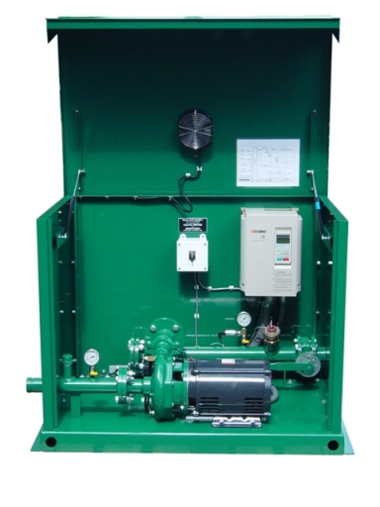
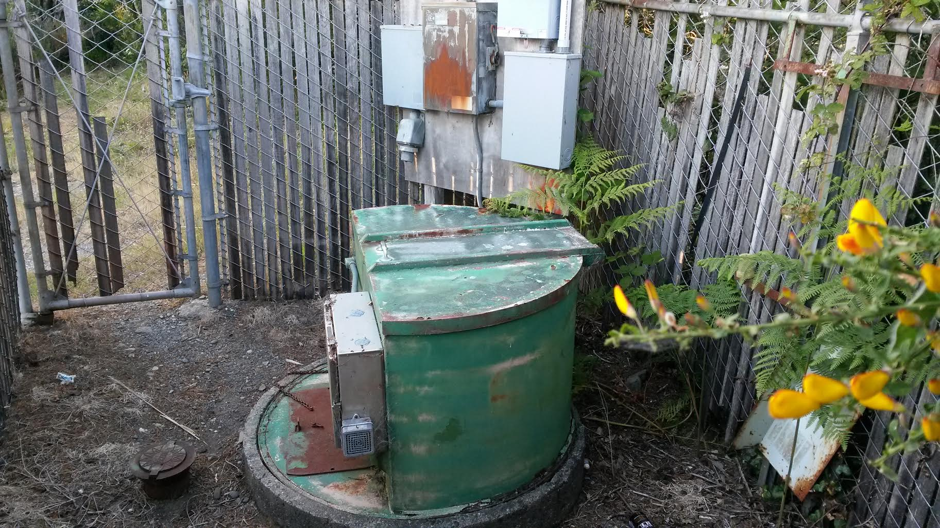
How big is a pump station?
Existing pump at Arizona Example new pump at WWTP (3’ X5’)

Slide 2
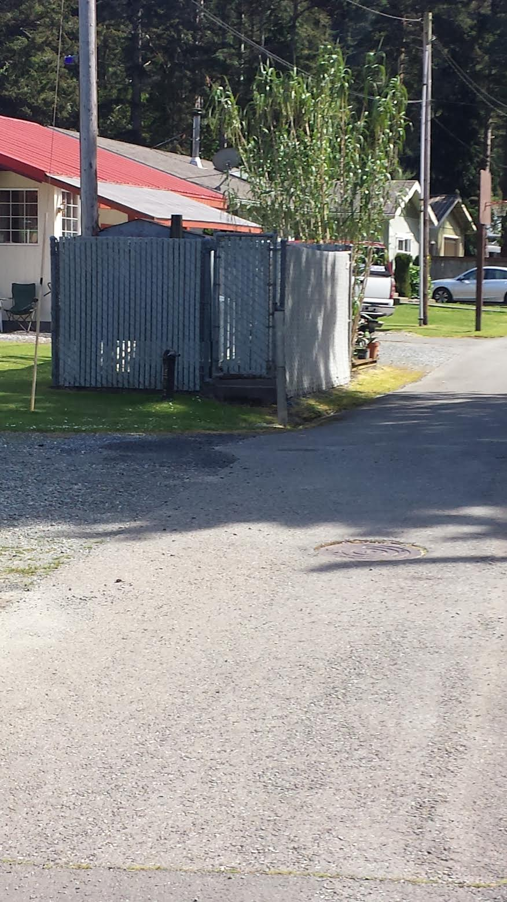
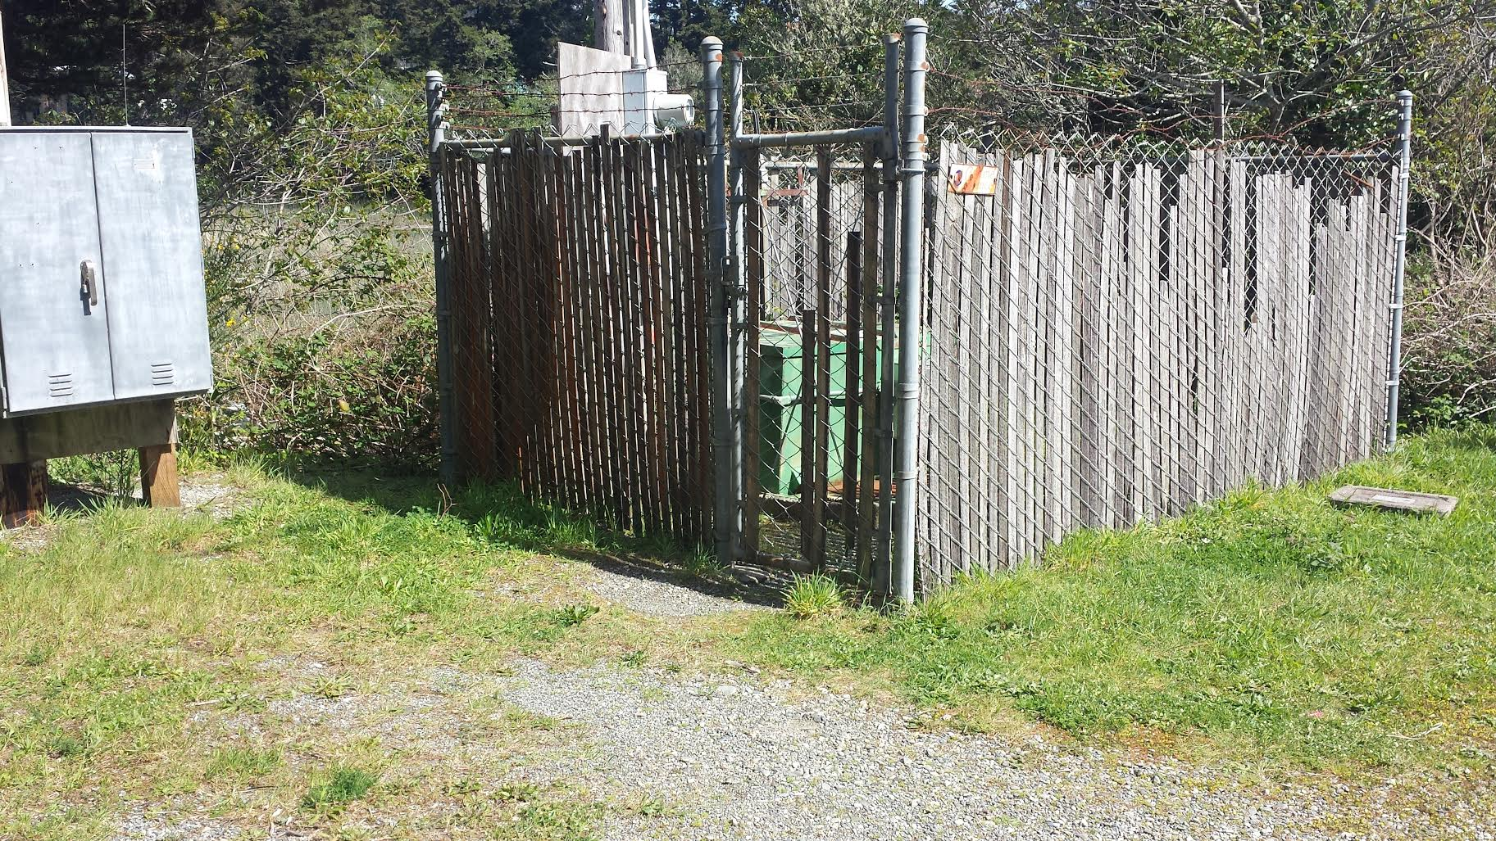
Will we see the pump station?
Existing pump station on Wyoming St Existing pump station on Arizona St

Slide 3
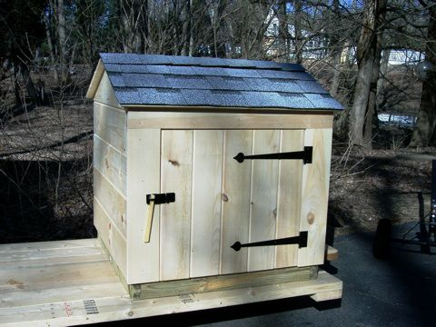
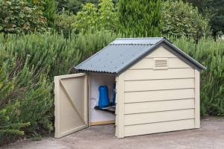
Example pump house for the pump station @ WWTP
Previously shown example pump station would be housed inside a small shed.

Slide 4
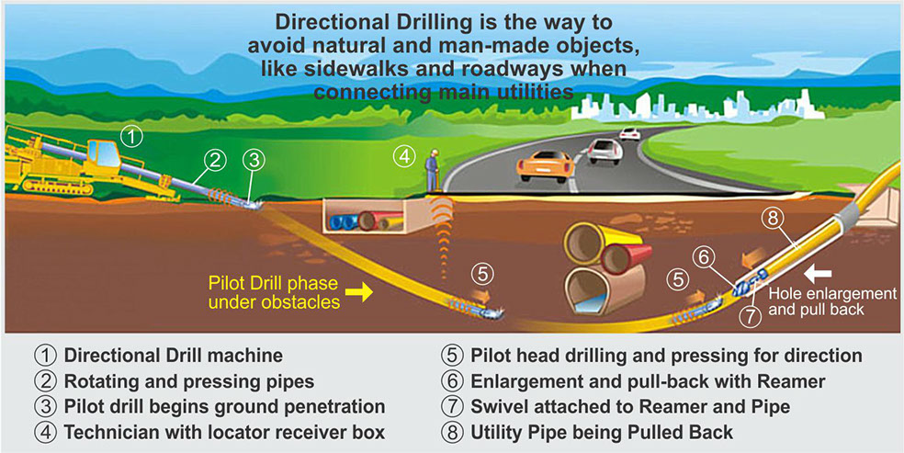

Slide 5
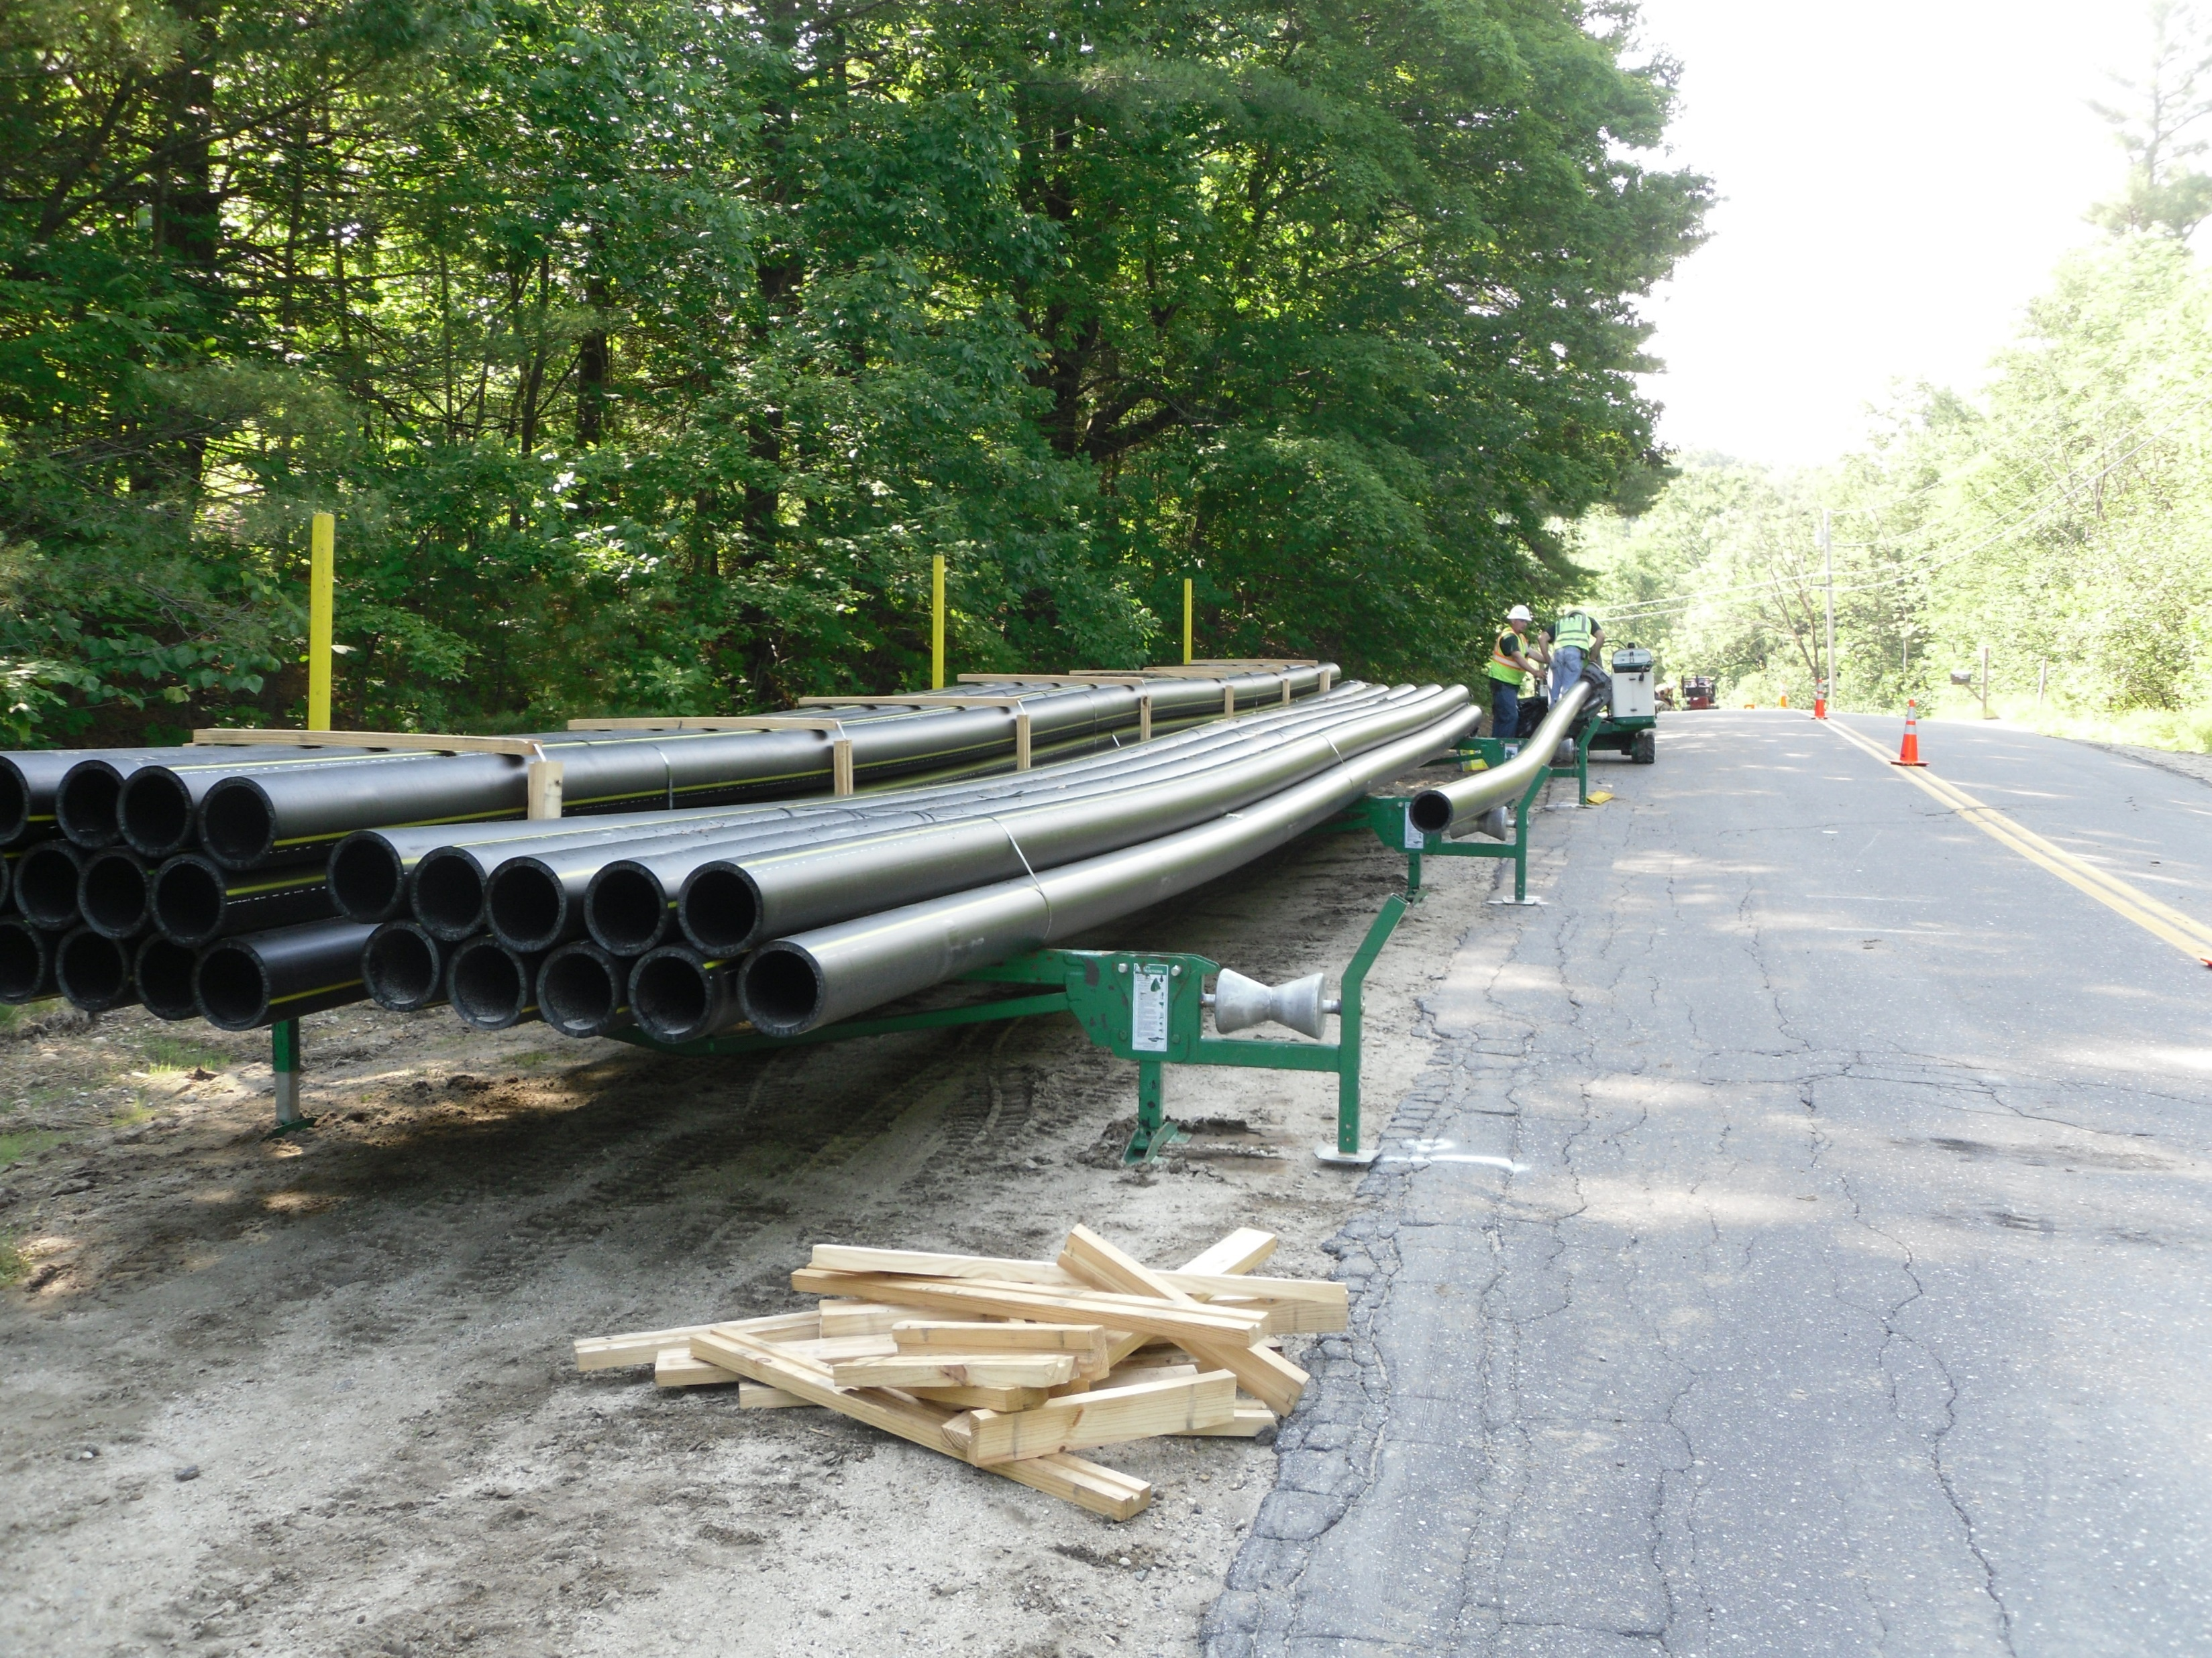
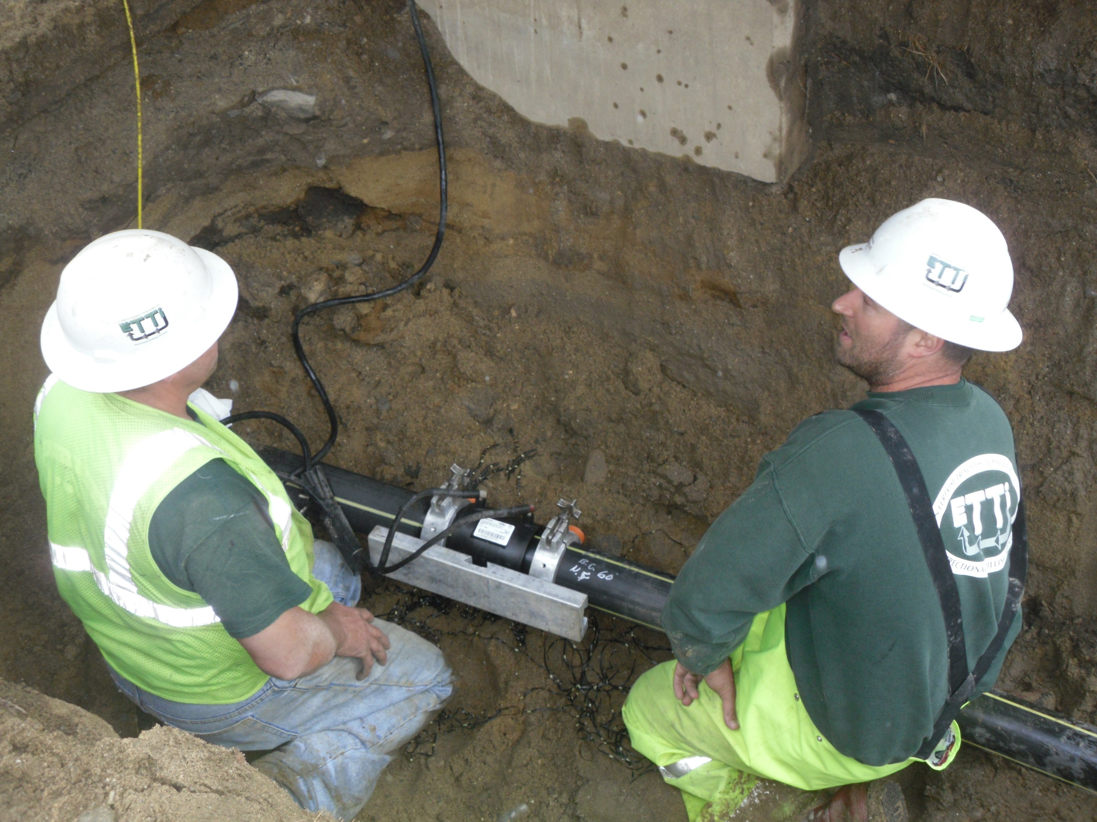
Typical scene at an HDPE water line installation
Fusing lengths of pipe roadside Fusing installed pipe in trench

Slide 6
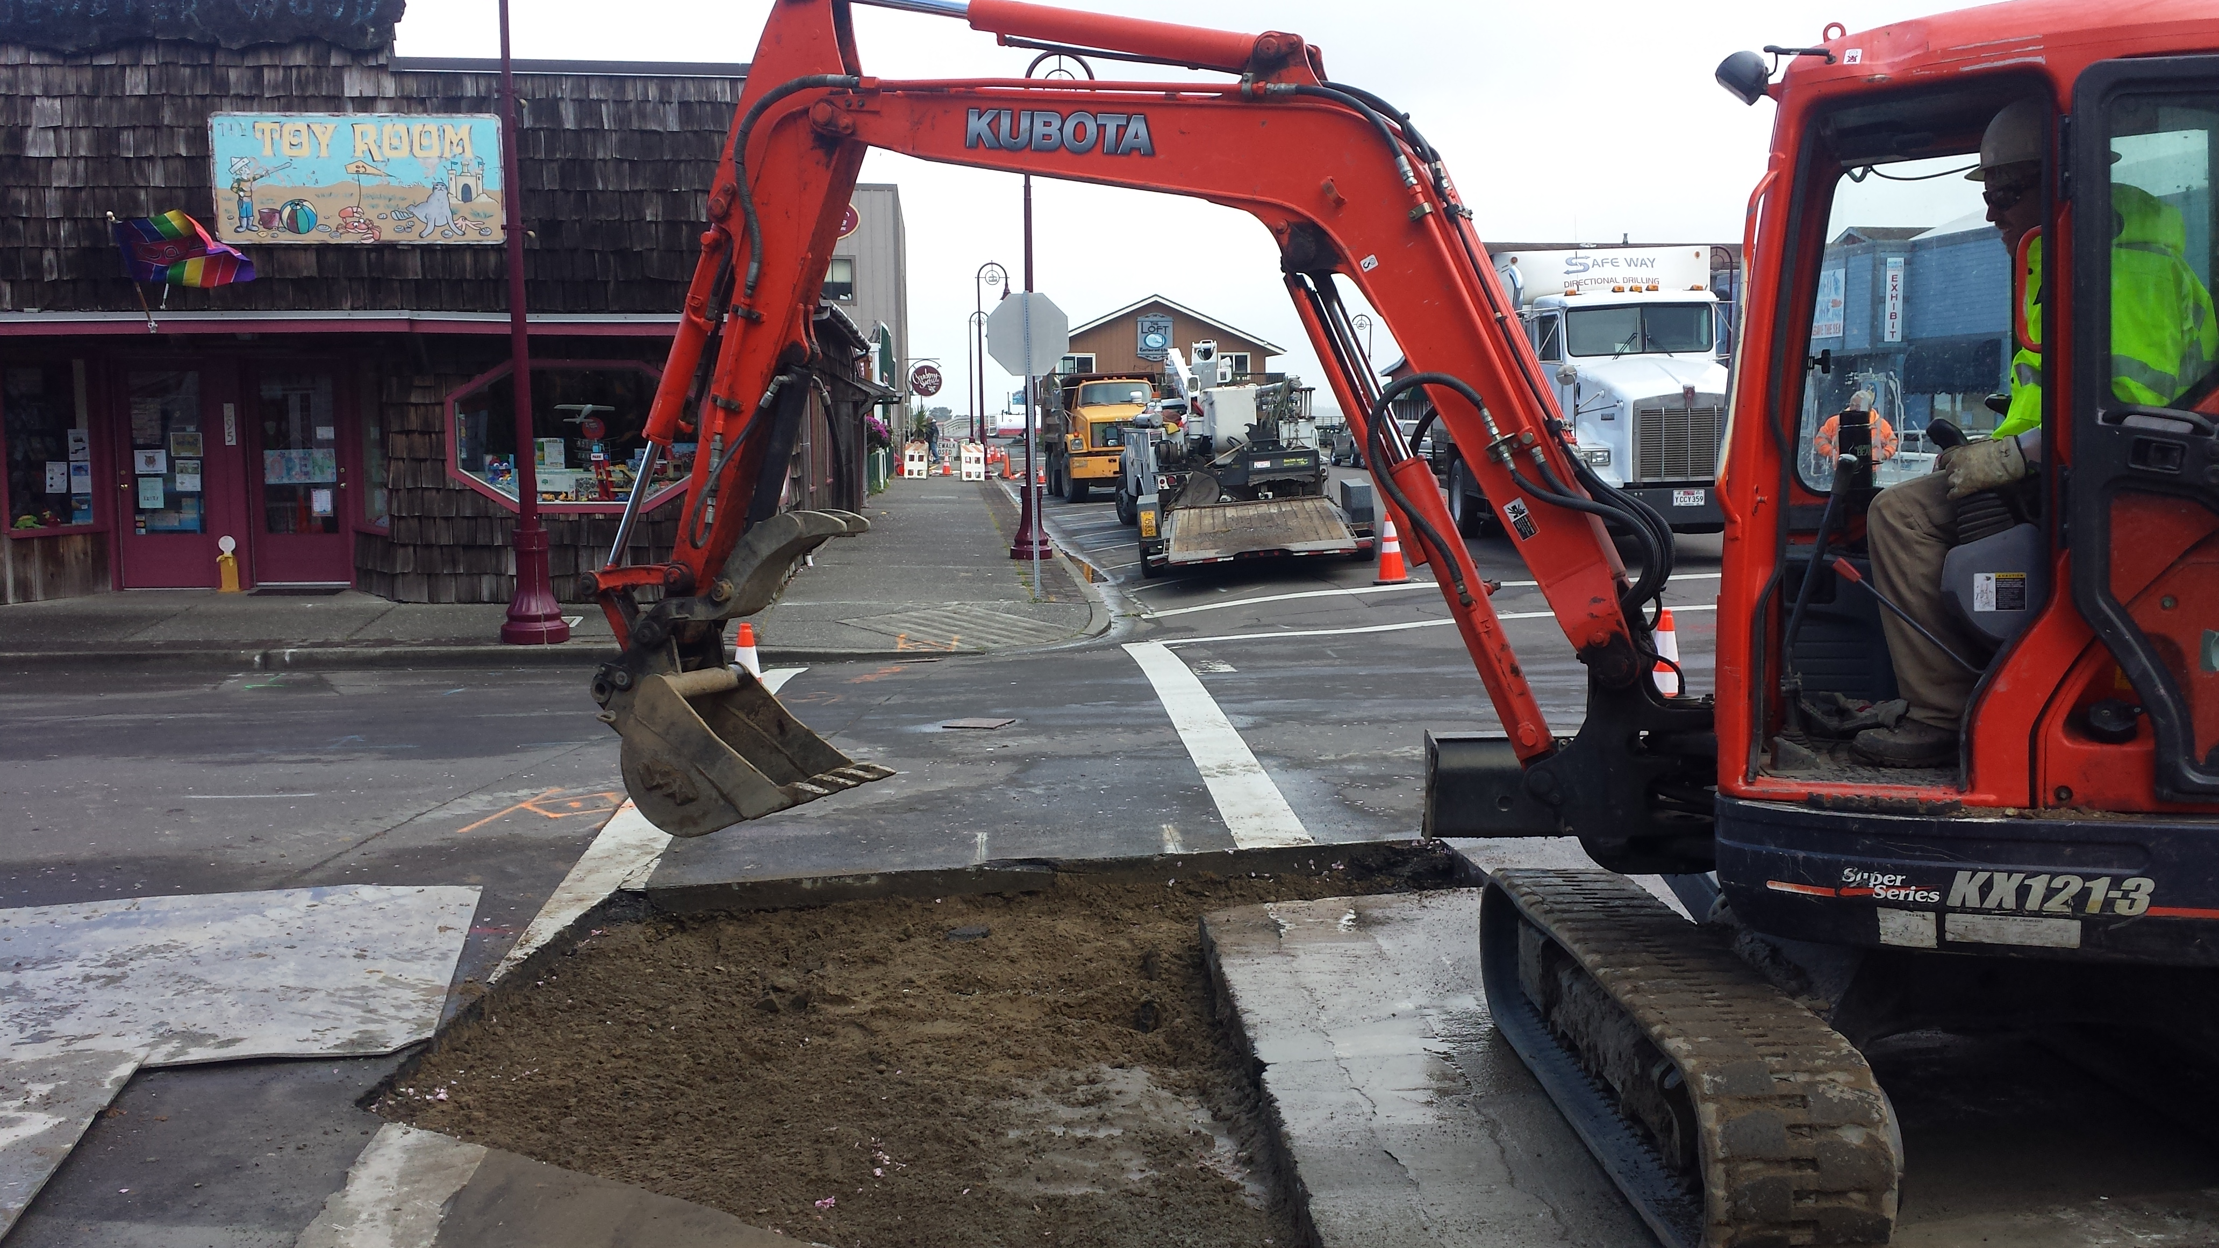

Slide 7
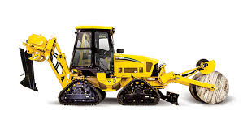
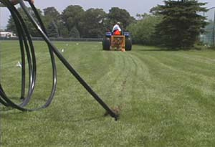
Installing pipe with a vibratory plow
Slicing, plow apartatus on back of machine. The apparatus is lowered to depth,
Pipe lengths are attached to the plow. and pipe gets pulled into the ground.

Slide 8
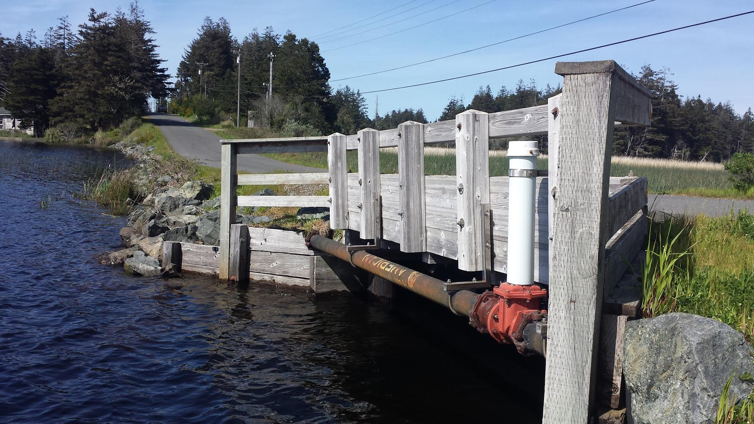
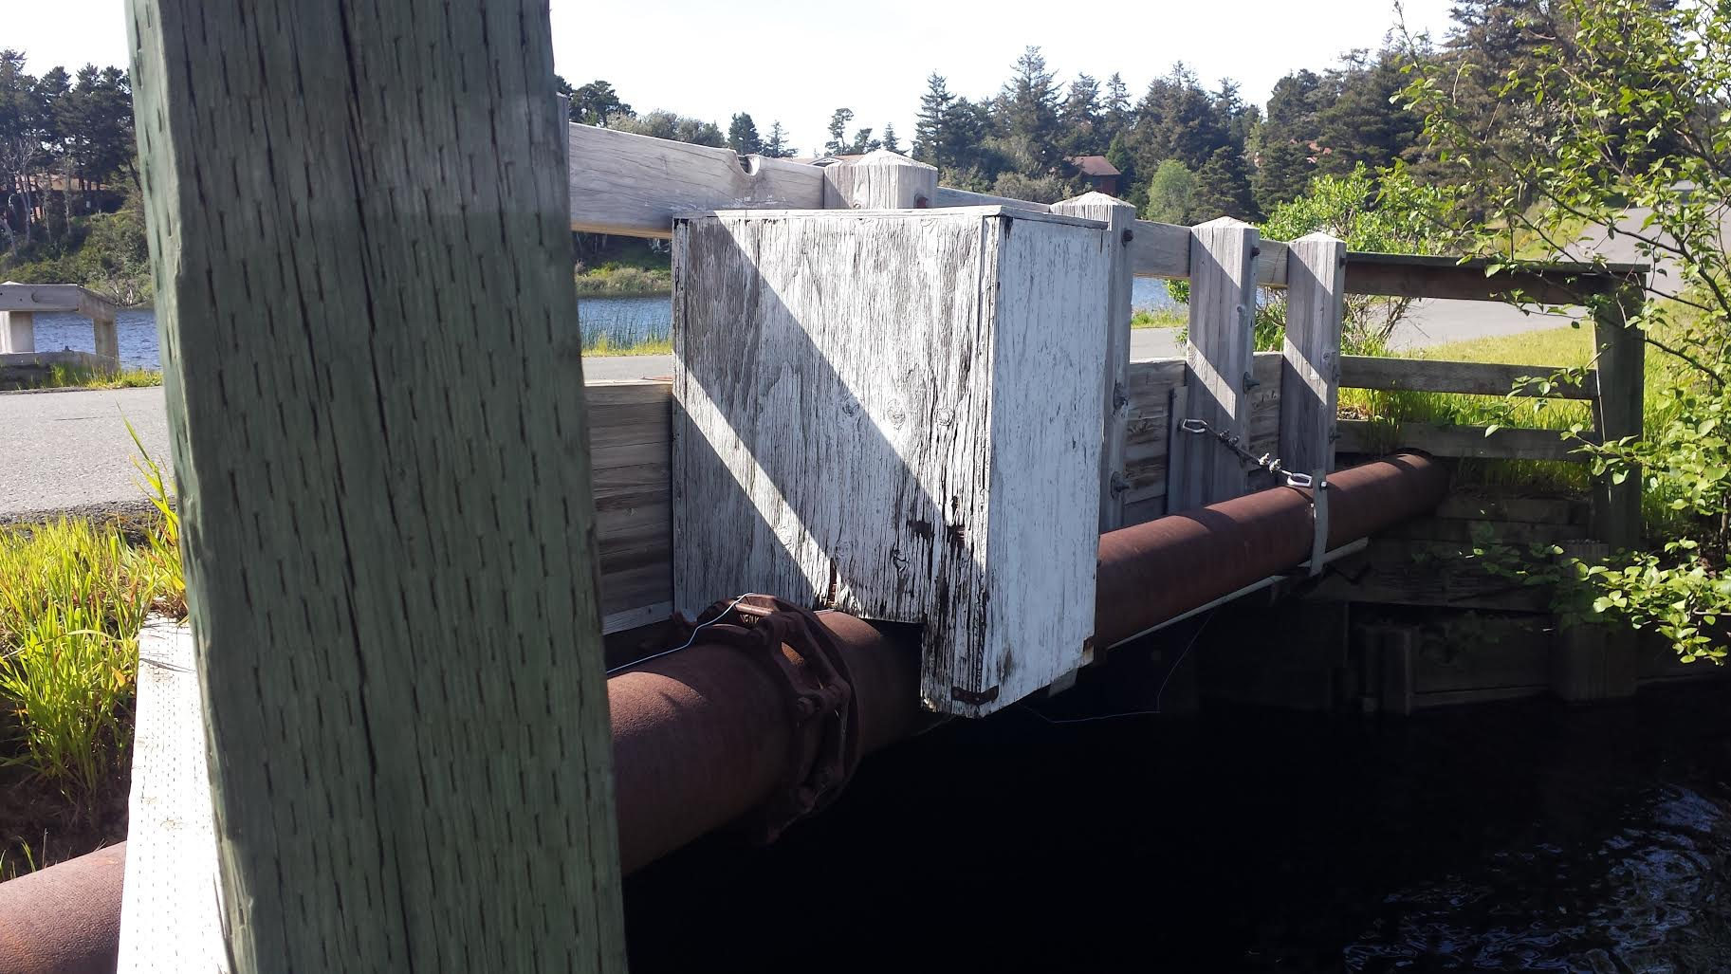
Existing water and sewer lines at Arizona St bridge
The effluent force main will likely be installed under the lake.

Slide 9
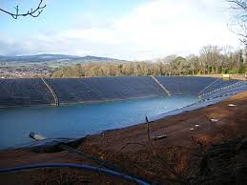
An example of a PVC lined irrigation reservoir

