Slide 1
Port orford Budget committee meeting FY 2026

Slide 2
Council goals FY 2026
Fiscally Responsible Operations
Utilities and Infrastructure
Administration
Planning
Staffing
Drinking Water
Wastewater
Facilities and Streets
Livability and Health
Public Safety
Communication
Parks

Slide 3
Agenda
Budget Message
Budget Overview/ Data Review
Future Challenges
Fund-by-Fund Approval
City Successes

Slide 4
Budget message
12 Funds: Start with the General Fund, review and adopt the other 11, and return to the General Fund to finalize the adoption.
Total Budget this year is $9,526,514 which is a 31% increase from last year’s adopted budget of $6,576,515.
To balance the budget, the Finance Committee used a combination of increasing revenues and decreasing expenditures.

Slide 5
Budget message
Ultimately, the recommended budget is balanced, but we need to grow our reserves soon for the stability of the City.
Financial Consultant, Ms. Heath, did a five-year reallocation to rectify the dwindling General Fund.
She also did a five-year projection based on this balanced budget.

Slide 6
City success!
This is a powerful tool in public speaking. It involves varying pitch, tone, and volume to convey emotion, emphasize points, and maintain interest:
$1.5m grant for the Community Building Complex
We own 60% of our watershed free and clear
Completed 2023 audit, and nearly done with 2024
variation
one inflection
Volume control
anguage enhances your
The Finance Committee has been working on this since January with Anne Heath
Union Contracts were ratified
Planning Grant is nearly done
making it more impactful and memorable:
Meaningful eye contact
Purposeful gestures
Maintain good posture
Control your expressions

Slide 7
Future Challenges
This is a powerful tool in public speaking. It involves varying pitch, tone, and volume to convey emotion, emphasize points, and maintain interest:
We need to increase our Contingency and Reserve funds
Grants will continue to be our way forward
Streets, Parks, and POPD need to become more self-sufficient in the future
variation
one inflection
Volume control
We need to come out of water curtailment to add more homes to the water system
Significant money is still needed to upgrade our aging and break-prone water system
ffective body language enhances your message, making it more impactful and memorable:
Meaningful eye contact
Purposeful gestures
Maintain good posture
Control your expressions

Slide 8
Changes Made Changes made Finance committee recommendations
Part-time Traffic Officer now Seasonal
Increased TLT Percentage
Public Safety Fee- $12 per month
Increased Utility Rates by 3%
Fewer Municipal Court Days

Slide 9
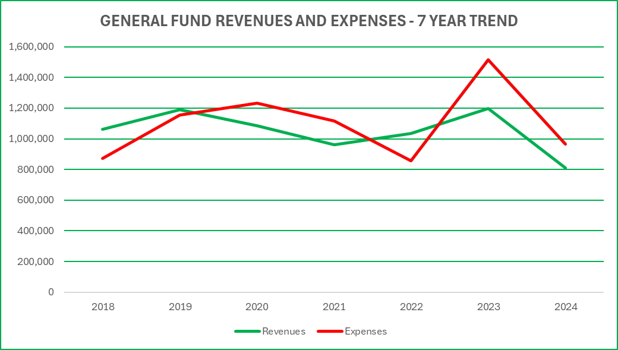
Data to support decisions General Fund
Know your material in advance
Anticipate common questions
Rehearse your responses
Maintaining composure during the Q&A session is essential for projecting confidence and authority. Consider the following tips for staying composed:
y calAndeye contact

Slide 10
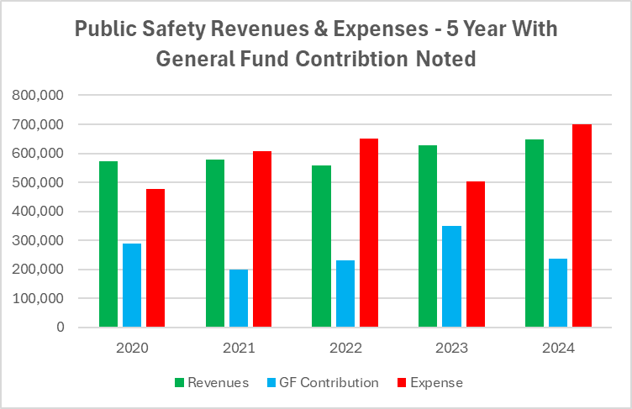
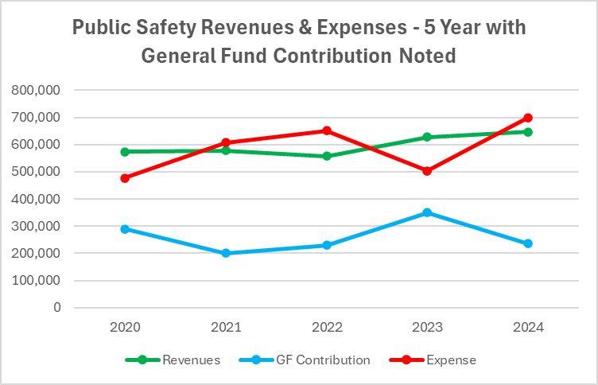
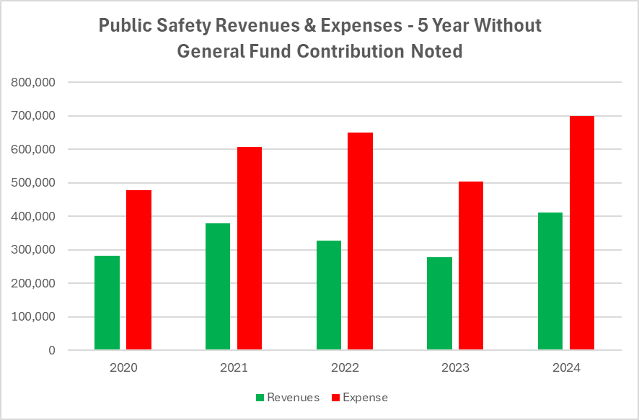
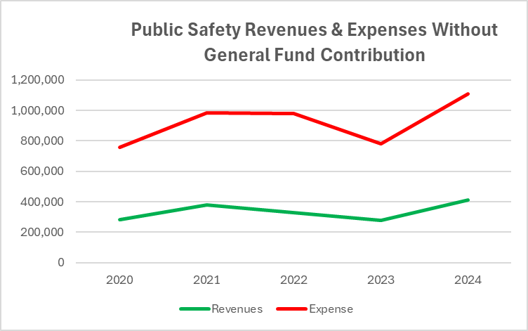
Public Safety
Know your material in advance
Anticipate common questions
Rehearse your responses
Maintaining composure during the Q&A session is essential for projecting confidence and authority. Consider the following tips for staying composed:
y calAndeye contact

Slide 11
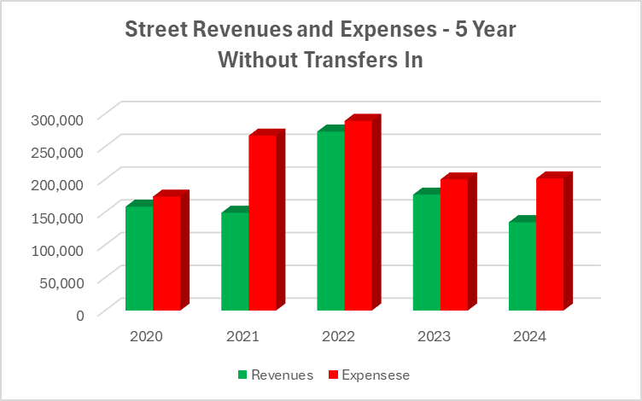
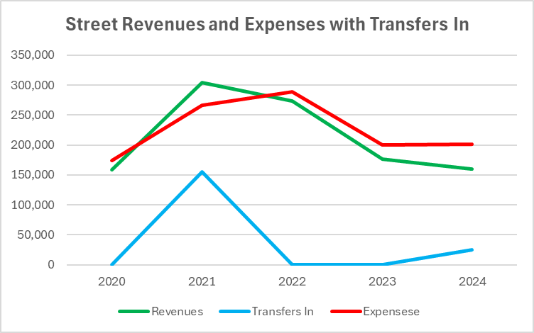
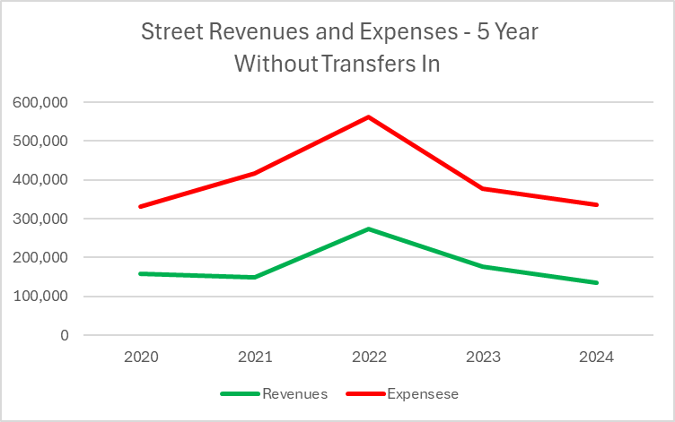
streets
Know your material in advance
Anticipate common questions
Rehearse your responses
Maintaining composure during the Q&A session is essential for projecting confidence and authority. Consider the following tips for staying composed:
y calAndeye contact

Slide 12
Contingency and ending fund balance
This is a powerful tool in public speaking. It involves varying pitch, tone, and volume to convey emotion, emphasize points, and maintain interest:
Currently at 9.2% of the total budget
We have $67,000 now
To get through “JASON” months, we need $160,000- $200,000
variation
one inflection
Volume control
ffectody language enhances your message, making it more impactful and memorable:
Control your expressions

Slide 13
Fund-by-Fund Review and Approval
This is a powerful tool in public speaking. It involves varying pitch, tone, and volume to convey emotion, emphasize points, and maintain interest:
ection
olume control

Slide 14
Thank you!

